Slide 1
Coursera Capstone Project
Predicting Place for New Shopping mall in Toronto, Canada

Slide 2
Business Report
Location for the shopping mall is one of the most important decisions that will predict wheter the mall will be a success or a faliure.
Our goal is to analyse the best locations in the city of Toronto, Canada for opening a new shopping mall.
Here Business Question is arises that: in the city of Toronto, if property developer is looking to open a new shopping mall, where would you recommend that they open it ?

Slide 3
Data acquisition and cleaning
List of neighborhood in Toronto, Canada.
Latitude and longitude coordinates of the neighborhood.
Venue data, mostly related to the shopping malls.
Wikipedia page for neighborhood(https://en.wikipedia.org/wiki/List_of_postal_codes_of_Canada:_M)
Geocoder package for latitude and longitude coordnates.
Foursqure API for venue data.

Slide 4
Methodology
Web scriping the Wikipedia page for neightborhood list.
Get latitude and longitude coordinates from usiing geocoder.
Use foursqure API to get venue data.
Group data by neighborhood and taking the mean of the frequency of occurence of each venue category.
Filter venue category by shopping mall
Performs clustering on the data by using k-means clustering
visulize the clusters in a map using folium.

Slide 5
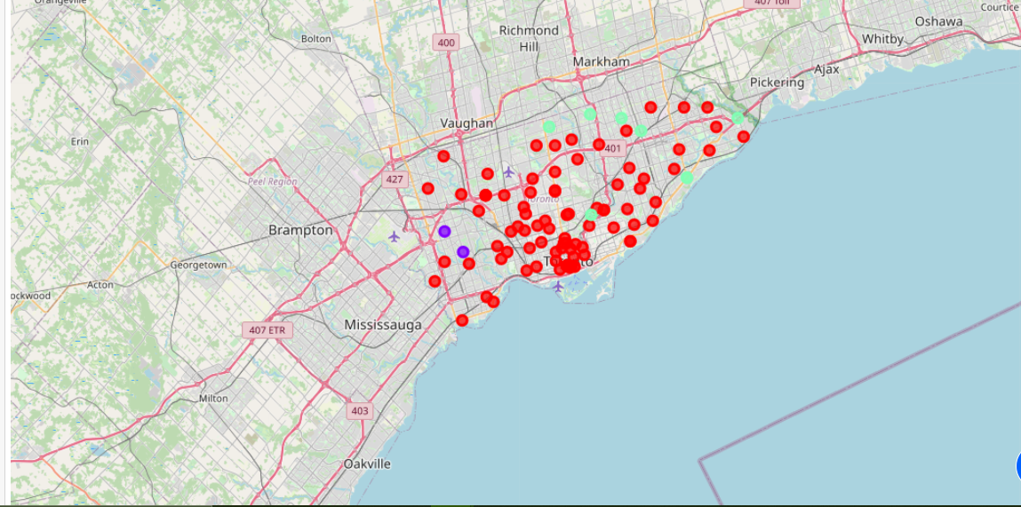
Results
Categorize the neighboorhood in 3 cluster:
Cluster 0: Neighborhoods with low number to no existence of shopping malls
Cluster 1: Neighborhoods with moderate number of shopping malls
Cluster 2: Neighborhoods with high concentration of shopping malls

Slide 6
Discussion
Most of the malls are the concentrated in the West area of city
HIghest number in cluster 2 and moderate in cluster 1.
Cluster 1 has very low to no shopping mall in the neighboorhoods.

Slide 7
Recommen-dation
open new shopping mall in neighborhood in cluster 0 with little to no competition
Avoid neighborhoods in cluster 2, already high concentration of shopping malls and intense competition
Can also open in neighborhood in Cluster 0 with moderate competition

Slide 8
Conculsion
Answer to business question: The neighborhoods in cluster 0 are the most predicted locations to open a new shopping mall
Finding of this project will help the relvent stakeholders to capitalize on the opppurnaties on high potential locations while avoiding overcroweded areas in their decision to open a nw shopping mall

Slide 9
THANKS

